Slide 1

UNIT-1
Introduction to MANAGEMENT
P. B. NARENDRA KIRAN
ASSISTANT PROFESSOR
MGN-502
Lovely Professional University

Slide 2
Who Are Managers?
Manager
  Someone who works with and through other people by coordinating their work activities in order to accomplish organizational goals

Slide 3
Types of Managers
First-line Managers
  Are at the lowest level of management and manage the work of nonmanagerial employees
Middle Managers
  Manage the work of first-line managers
Top Managers
  Are responsible for making organization-wide decisions and establishing plans and goals that affect the entire organization

Slide 4
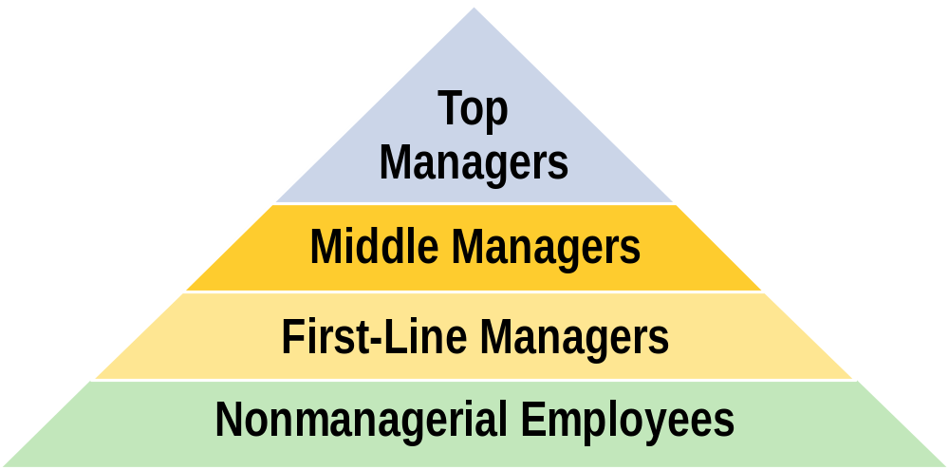
Managerial Levels

Slide 5

Where Managers Work
Organization
A consciously coordinated social unit, composed of two or more people, that functions on a relatively continuous basis to achieve a common goal or set of goals.

Slide 6
Definition of Management:
Management is the process of designing and maintaining an environment in which individuals, working together in groups, efficiently accomplish selected aims

Slide 7
Definitions of Effectiveness and Efficiency
Productivity implies effectiveness and efficiency in individual and organizational performance
Effectiveness is the achievement of objectives
Efficiency is the achievement of the ends with the least amount of resources (time, money, etc.)

Slide 8
Managerial Concerns
  Efficiency
    “Doing things right”
      Getting the most output for the least input
  Effectiveness
    “Doing the right things”
      Attaining organizational goals

Slide 9
What Managers Do
Managers (or administrators)
Individuals who achieve goals through other people.
Managerial Activities
Make decisions
Allocate resources
Direct activities of others to attain goals

Slide 10
What Do Managers Do?
Functional Approach
  Planning
  Organizing
  Leading
  Controlling

Slide 11

Management Functions (cont’d)
Planning
A process that includes defining goals, establishing strategy, and developing plans to coordinate activities.

Slide 12
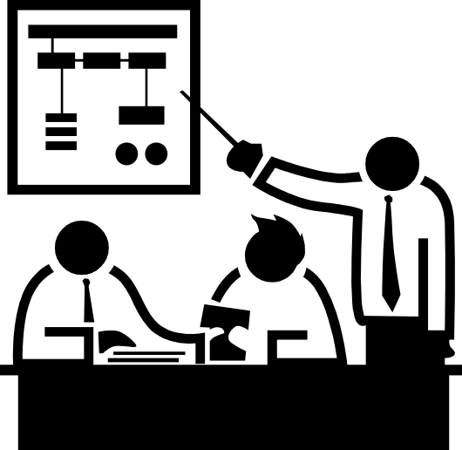
Management Functions (cont’d)
Organizing
Determining what tasks are to be done, who is to do them, how the tasks are to be grouped, who reports to whom, and where decisions are to be made.

Slide 13

Management Functions (cont’d)
Leading
A function that includes motivating employees, directing others, selecting the most effective communication channels, and resolving conflicts.

Slide 14

Management Functions (cont’d)
Controlling
Monitoring activities to ensure they are being accomplished as planned and correcting any significant deviations.

Slide 15
Management Functions
Planning
Organizing
Leading
Controlling
Lead to
Defining goals,
Determining
Directing and
Monitoring
establishing
what needs
motivating all
activities
Achieving the
strategy, and
to be done,
involved parties
to ensure
organization
’
s
developing
how it will
and resolving
that they are
stated
subplans to
be done, and
conflicts
accomplished
purpose
coordinate
who is to do it
as planned
activities

Slide 16
What Do Managers Do? (cont’d
Mintzberg’s Management Roles Approach
  Interpersonal roles
    Figurehead, leader, liaison
  Informational roles
    Monitor, disseminator, spokesperson
  Decisional roles
    Entrepreneur, disturbance handler, resource allocator, negotiator

Slide 17
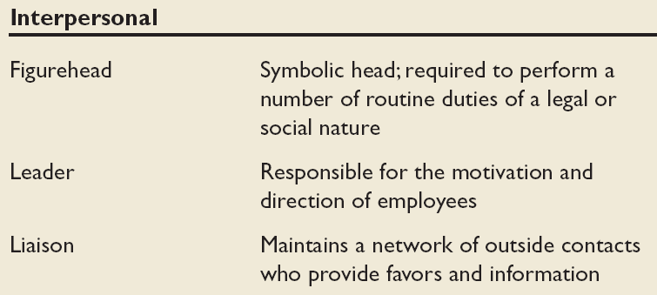
Mintzberg’s Managerial Roles

Slide 18
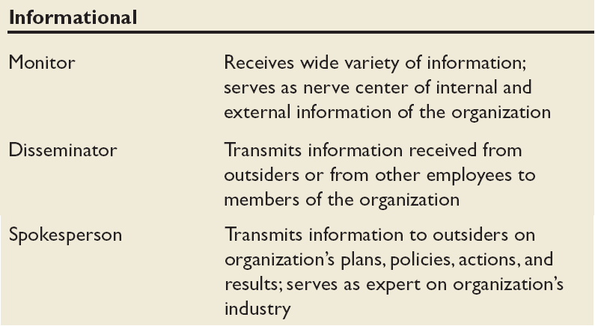
Mintzberg’s Managerial Roles (cont’d)

Slide 19
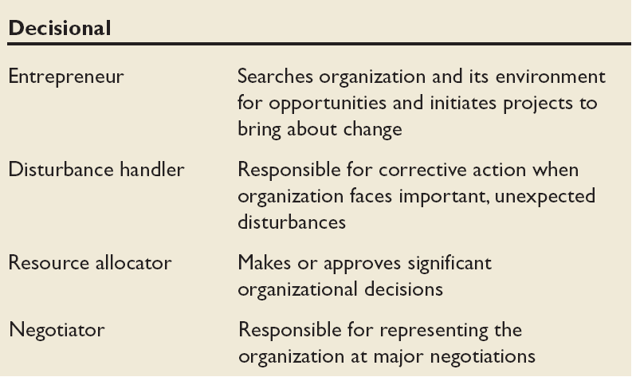
Mintzberg’s Managerial Roles (cont’d)

Slide 20
What Do Managers Do? (cont’d)
Skills Approach
  Technical skills
  Human skills
  Conceptual skills

Slide 21

Management Skills
Technical skills
The ability to apply specialized knowledge or expertise.
Human skills
The ability to work with, understand, and motivate other people, both individually and in groups.
Conceptual Skills
The mental ability to analyze and diagnose complex situations.

Slide 22
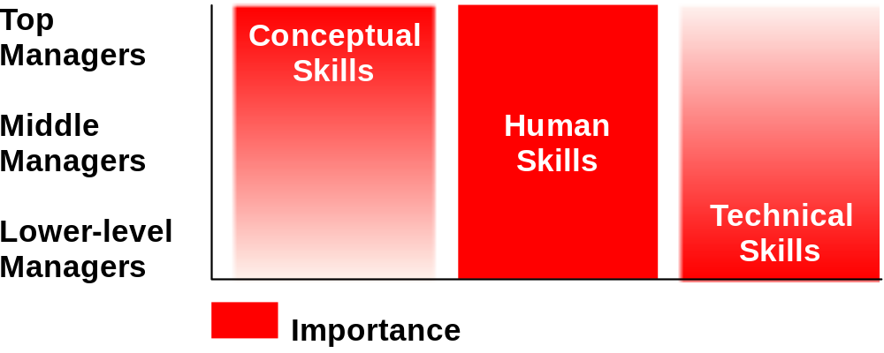
Skills Needed at Different Management Levels

Slide 23
What Is An Organization?
An Organization Defined
  A deliberate arrangement of people to accomplish some specific purpose
Common Characteristics of Organizations
  Have a distinct purpose (goal)
  Are composed of people
  Have a deliberate structure

Slide 24
The Changing Organization
Traditional
Stable
Inflexible
Job-focused
Work is defined by job positions
Individual-oriented
Permanent jobs
Command-oriented
Managers always make decisions
Rule-oriented
Relatively homogeneous workforce
Workdays defined as 9 to 5
Hierarchial relationships
Work at organizational facility during specific hours
New Organization
Dynamic
Flexible
Skills-focused
Work is defined in terms of tasks to be done
Team-oriented
Temporary jobs
Involvement-oriented
Employees participate in decision making
Customer-oriented
Diverse workforce
Workdays have no time boundaries
Lateral and networked relationships
Work anywhere, anytime

Slide 25
Management: Definition
Acc to Harold Koontz: Management is the art of getting things done through & with an formally organized group
Acc to Henry Fayol: To manage is to forecast & plan, to organize, to compound, to co-ordinate and to control
POSDCORB: (Luther Gullick)
- Planning, Organizing, Directing, Staffing, Co-ordinating, Reporting & Budgeting

Slide 26
Features of Management
Art as well as Science
Management is an activity
Management is a continuous process
Management achieving pre-determined objectives
Organized activities
Management is a factor of production
Management as a system
Management is a discipline

Slide 27
Features of Management
Management is a distinct entity
Management aims at maximising profit
Management is a purposeful activity
Management is a profession
Universal application
Management is getting things done
Management is needed at all levels

Slide 28
Importance of Management
Management meet the challenge of change
Accomplishment of group goals
Effective utilization of resources
Effective functioning of business
Resource Development
Sound organization Structure
Management directs the organization
Integrates various interests
Stability

Slide 29
Importance of Management
Innovation
Co-ordination and team-spirit
Tackling problems
A tool for Personality Development

Slide 30
Henry Fayol (1841-1925)
Was a french industrialist
Given :
  Elements of Management- Planning, Organizing, Commanding, Co-ordination & Control
  Qualities of Manager: Physical, Mental, Moral, General Education, Special Knowledge & Experience
  Principles of Management

Slide 31
Principles of Management
Division of work
Authority & responsibilty
Discipline
Unity of command
Unity of direction
Subordinate of individual interest to group interest
Remuneration of personnel
Centralization
Scalar Chain

Slide 32
Principles of Management
Order
Equity
Stability of tenure of personnel
Initiative
Espirit De Corps

